Slide 1

Binary Tree Operations
1. insert
2. Iterative Preorder 3. Iterative inorder 4. Iterative level order 5. copy 6. printAncestors 7. parent 8. Height of a tree

Slide 2
Binary Tree 1. CreateBT (recursive) and insert a new node (Iterative)
2. iterativePreorder 3. iterativeinorder 4. Iterative level_order 5. copy 6. printAncestors 7. parent 8. Height of a tree

Slide 3
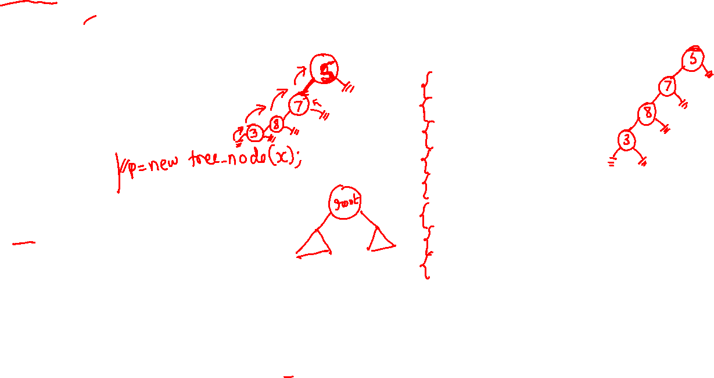
Creating BT in recursive manner
treenode *createBT()
{
treenode *p;
int x;
cout<<"Enter data(-1 for no data):";
cin>>x;
if(x==-1)
return NULL;
p=new tree_node;
p->data=x;
cout<<"Enter left child of “<<x<<“:”;
p->lc=createBT();
cout<<"Enter right child of “<<x<<“:”;
p->rc=createBT();
return p;
}
Binary tree creation using recursive method.
Enter data(-1 for no data):5 Enter left child of 5: Enter data(-1 for no data):7 Enter left child of 7: Enter data(-1 for no data):8 Enter left child of 8: Enter data(-1 for no data):3 Enter left child of 3: Enter data(-1 for no data):-1 Enter right child of 3: Enter data(-1 for no data):-1 Enter right child of 8: Enter data(-1 for no data):-1 Enter right child of 7: Enter data(-1 for no data):-1 Enter right child of 5: Enter data(-1 for no data):-1
Calling create function in main
root=createBT();

Slide 4
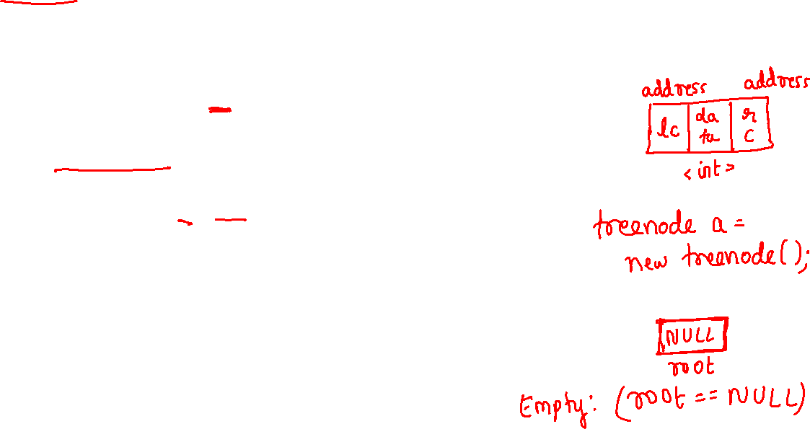
class treenode
{
treenode* leftchild; int data; treenode* rightchild;
public:
treenode(int element=0)
{
data=element; leftchild=NULL; rightchild=NULL;
}
treenode* insert(int,treenode*);
void iterativePreorder(tree_node*);
void iterativeinorder(tree_node *);
void level_order(treenode* ptr);
treenode *copy(treenode *ptr);
int treenode::printAncestors(treenode *root, int target)
treenode* parent(treenode *,int ele);
int treenode::depth(treenode *ptr);
};
treenode* root=NULL;
1. insert

Slide 5
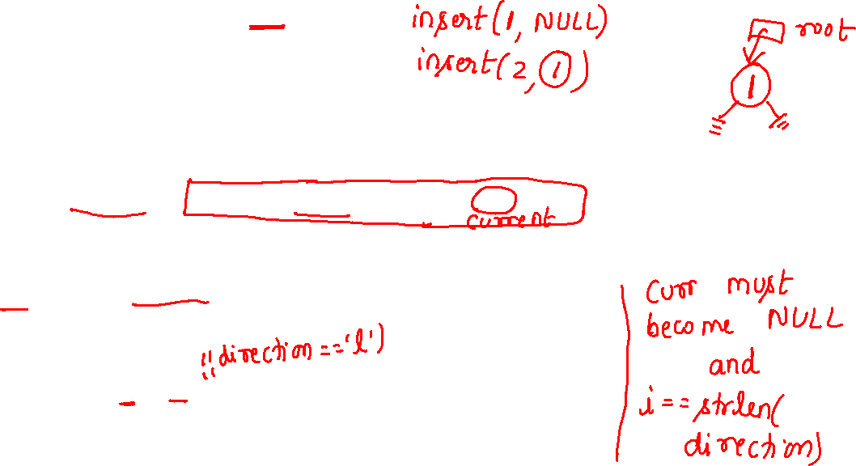
treenode *treenode::insert(int item,treenode* root)
{
treenode* temp=new treenode(item);
if(root==NULL)
{ root=temp; return root; }
char direction[20];
cout<<"enter direction in uppercase: “; cin>>direction;
treenode* current; treenode* prev; //parent of new node
prev=NULL; current=root;
int i;
for(i=0;i<strlen(direction)&&current!=NULL;i++)
{
prev=current;
if(direction[i]=='L’) current=current->leftchild;
else current=current->rightchild;
}
1. insert

Slide 6
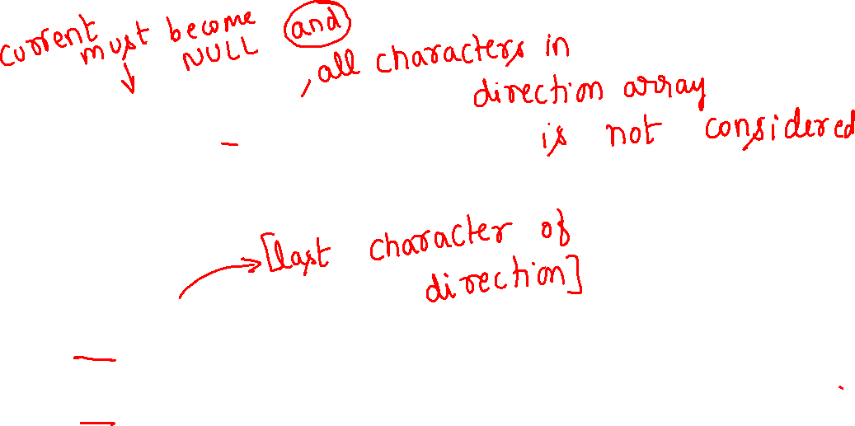
1. insert
if(current!=NULL||i!=strlen(direction))
{
cout<<"insertion not possible";
delete temp;
return root;
}
if(direction[i-1]=='L')
prev->leftchild=temp;
else
prev->rightchild=temp;
return root;
}

Slide 7
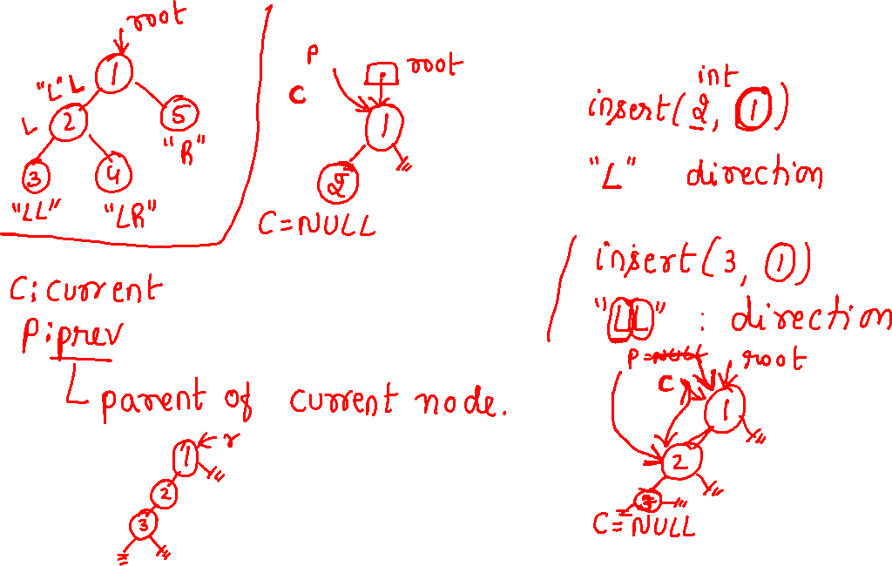

Slide 8
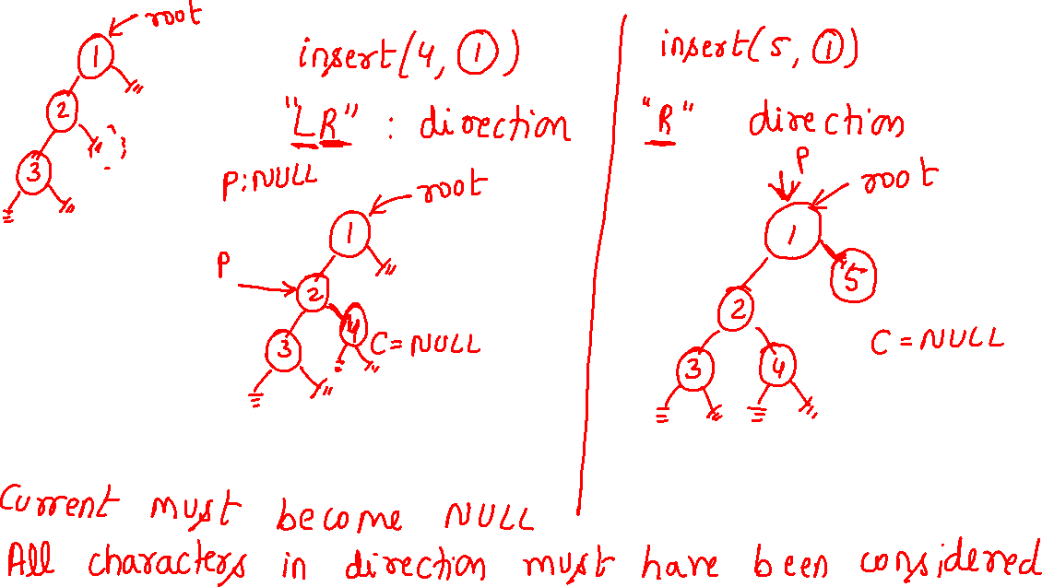

Slide 9
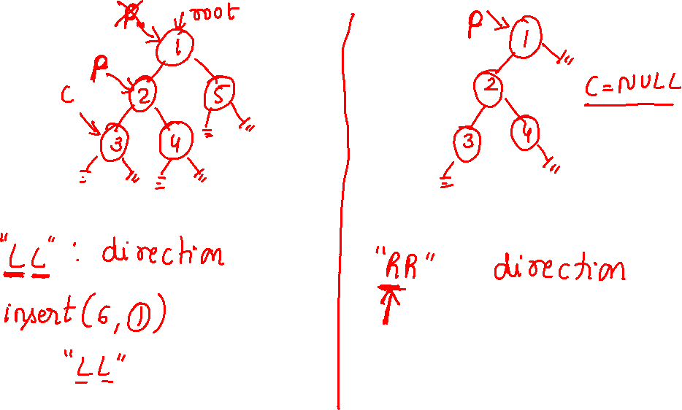

Slide 10
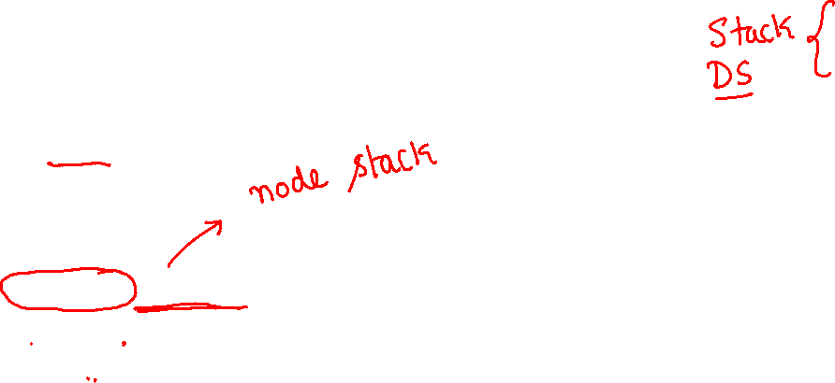
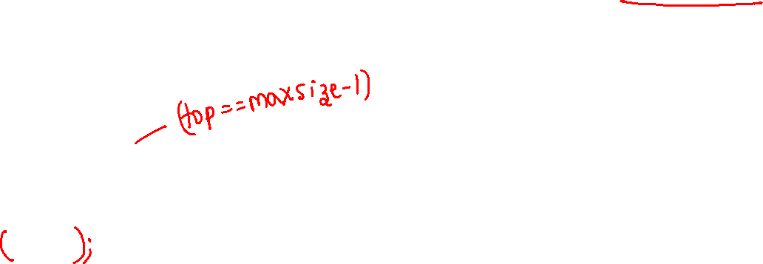
Node stack implementation
2. iterativePreorder 3. iterativeinorder
// Stack type
class Stack
{
int size;
int top;
treenode* array[10];
Stack(){size=10; top=-1;}
int isFull()
{ return((top+1)==size); }
int isEmpty()
{ return top==-1; }
void push(treenode* node)
{
if (isFull())
return;
array[++top] = node;
}

Slide 11

Node stack implementation
2. iterativePreorder 3. iterativeinorder
treenode* pop()
{
if (isEmpty()) return NULL;
return array[top--];
}
treenode* peek()
{
if (isEmpty()) return NULL;
return array[top];
}
};

Slide 12
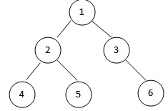
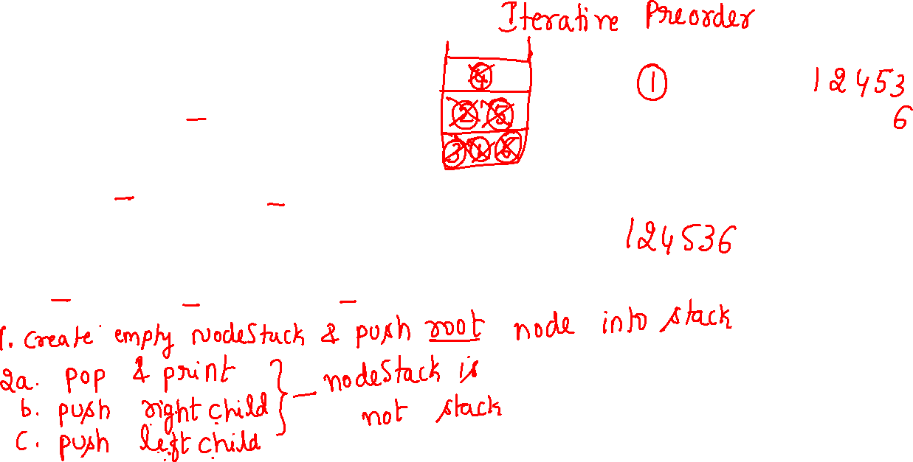

Slide 13
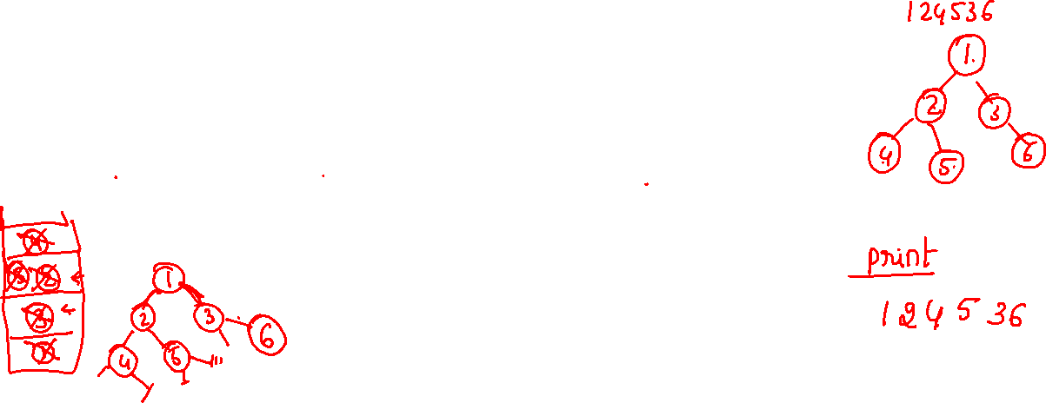
2. Iterative Preorder traversal algorithm
1. Create an empty stack nodeStack and push root node to stack
2. Do following while nodeStack is not empty
a. Pop an item from stack and print it. b. Push right child of popped item to stack c. Push left child of popped item to stack

Slide 14

// An iterative process to print preorder traversal of Binary tree
void treenode::iterativePreorder(tree_node *root)
{
// Base Case
if (root == NULL) return;
tree_node* curr=root; // 1. Create an empty stack and push root to it
stack S;
S.push(curr);
for(;;) {
curr=S.pop(); //a. Pop an item from stack and print it.
if(curr==NULL) break; //2. Do following while nodeStack is not empty
cout<<curr->data; //a. Pop an item from stack and print it.
if (curr->rc) S.push(curr->rc); //b. Push right child of popped item to stack
if (curr->lc) S.push(curr->lc); //c. Push left child of popped item to stack
}
}
2. Iterative Preorder

Slide 15
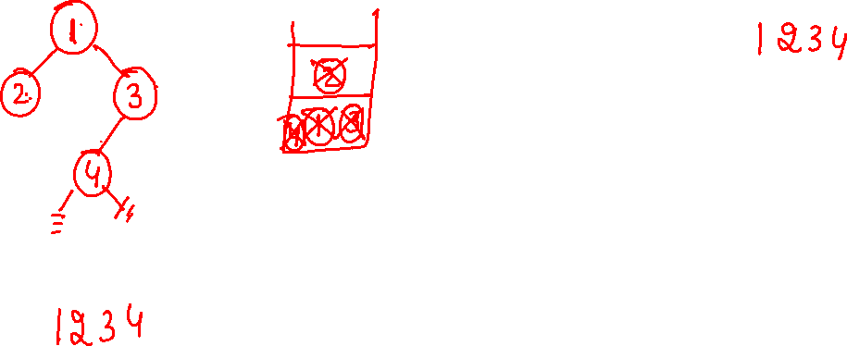


Slide 16

Iterative inorder traversal
3. Iterative inorder
1) Create an empty stack S.
2) Initialize current node as root
3) Push the current node to S if not NULL and set current = current->left until current becomes NULL(repeat)
4) If stack is not empty then
a) Pop the top item from stack. [if popped item is NULL go to Step 5]
b) Print the popped item and print it’s value,
set current =popped_node->right
c) Go to step 3.
5) stack is empty then we are done.

Slide 17
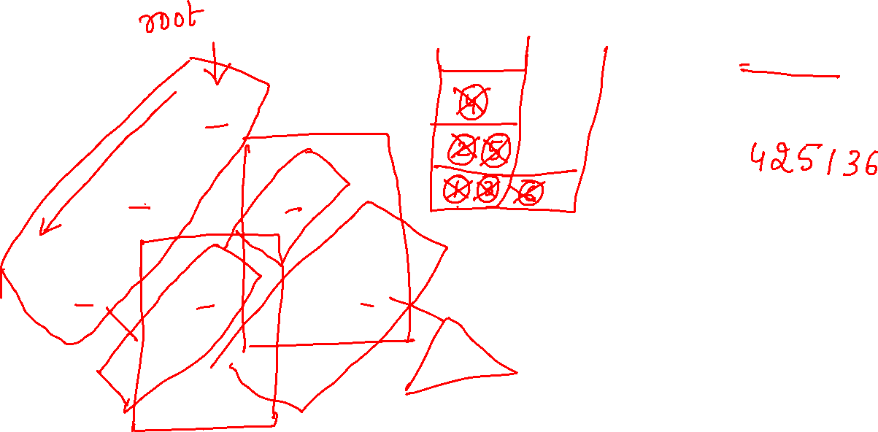
3. Iterative inorder

Slide 18


void treenode::iterativeinorder(tree_node *root)
{
// Base Case
if (root == NULL) return; //empty tree
stack S; //1) Create an empty stack S.
tree_node *curr=root; //2) Initialize current node as root
for(::){
for(;curr;curr=curr->lc) S.push(curr); //3) Push the current node to S if not
//NULL and set current = current->left until current becomes NULL(repeat)
curr=S.pop();
if (curr==NULL) break; //5) stack is empty then we are done.
cout<<curr->data;
curr=curr->rc;
}
}
3. Iterative inorder

Slide 19
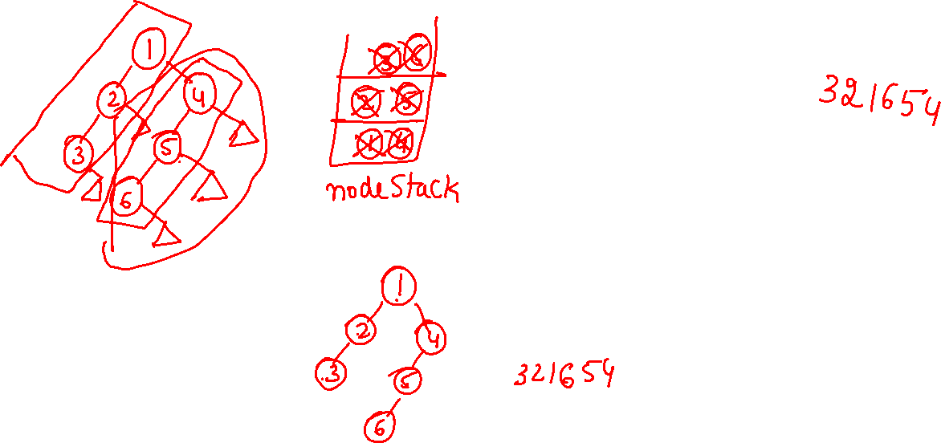


Slide 20
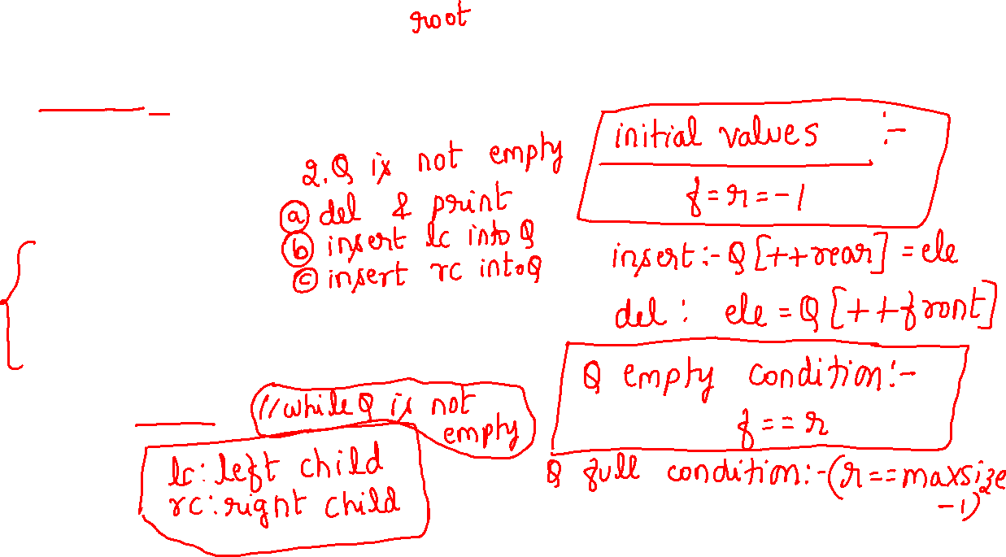
void treenode::level_order(treenode* ptr)
{
int front=-1; int rear=-1;
treenode *Q[10];
if(!ptr) return; //empty tree
Q[++rear]=ptr;
do
{
ptr=Q[++front];
cout<<ptr->data<<" ";
if(ptr->leftchild) Q[++rear]=ptr->leftchild;
if(ptr->rightchild) Q[++rear]=ptr->rightchild;
}while(front!=rear);
}
4. Iterative levelorder

Slide 21
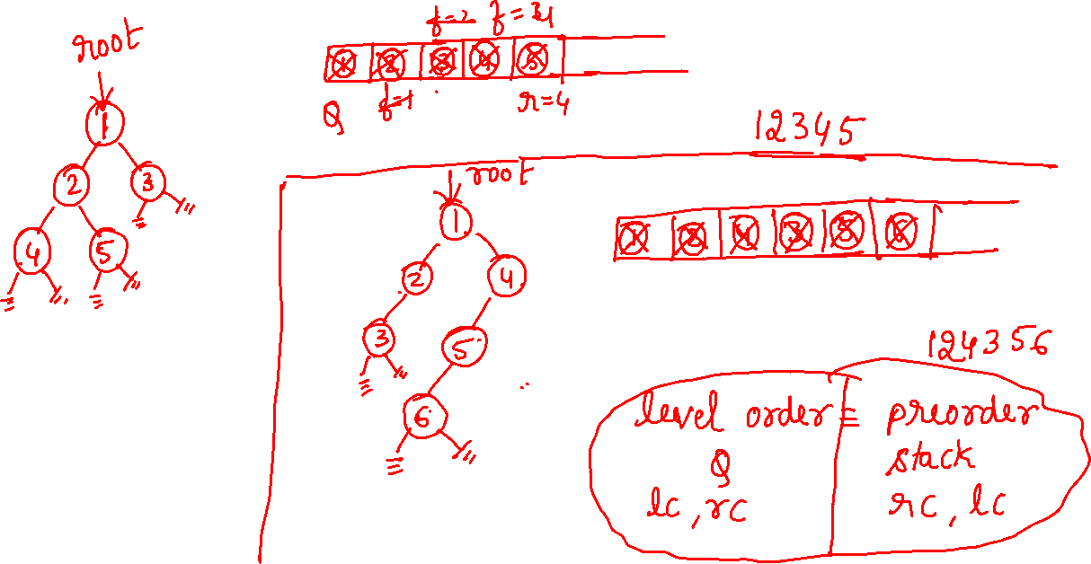

Slide 22
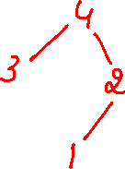


Copying a BT
5. copy
Copy(4) creates a temp node, copies 4 into it.
Calls ->lc=copy( )
Copy( ) creates a temp node, copies 3 into it. Calls ->lc=copy( NULL) //copy(NULL) call returns NULL
Calls ->rc=copy( NULL) //copy(NULL) call returns NULL
Calls ->rc=copy( )
Copy( ) creates a temp node, copies 2 into it. Calls ->lc=copy( ) //creates a node with value 1 and
//returns it’s address
Calls ->rc=copy( NULL) //copy(NULL) call returns NULL
4
3
3
3
3
4
2
2
2
1
2

Slide 23
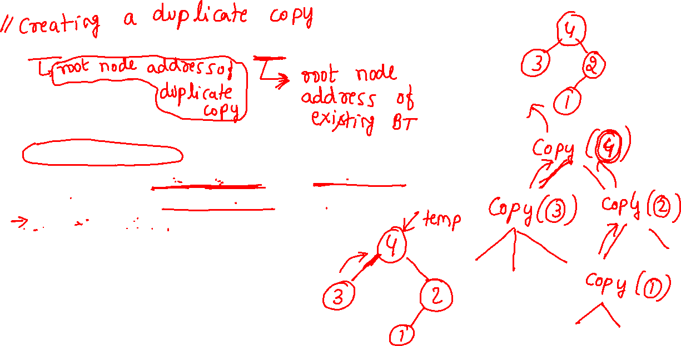

Copying a BT
5. copy
treenode *treenode::copy(treenode *ptr)
{
treenode *temp;
if(ptr)
{
temp=new treenode;
if(ptr->leftchild) temp->leftchild=copy(ptr->leftchild);
if(ptr->rightchild) temp->rightchild=copy(ptr->rightchild);
temp->data=ptr->data;
return(temp);
}
return(NULL);
}

Slide 24
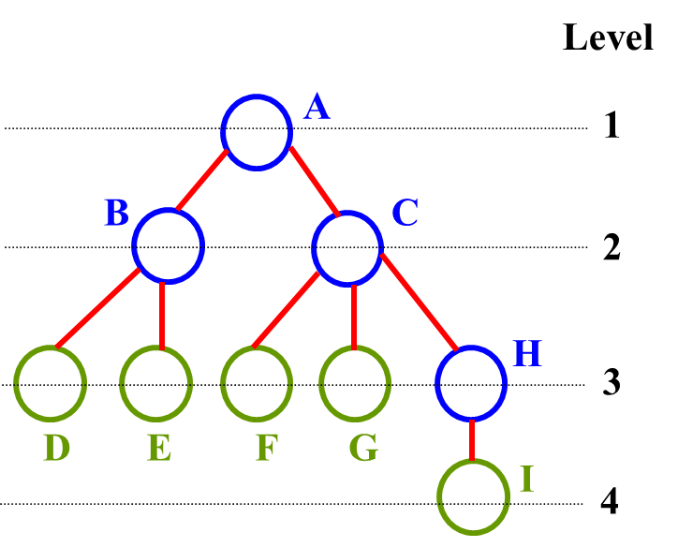
8. Height of a tree
The height (depth) of the tree is 4
Height (or depth): the maximum level of any node in the tree

Slide 25
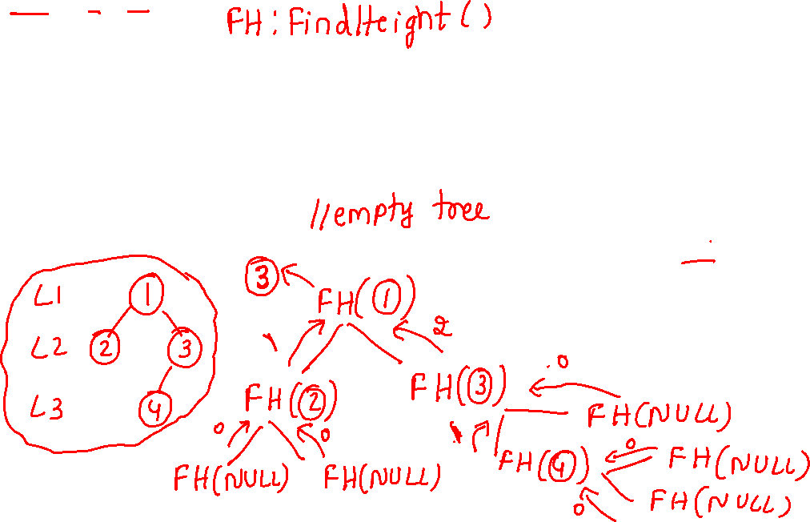
int max(int a,int b)
{
int m=(a>b)?a:b;
return(m);
}
int treenode::FindHeight(treenode *r)
{
if(root==NULL) return(0);
return( max(FindHeight(r->leftchild), FindHeight(r->rightchild)) +1);
}
8. Height of a tree

